Slide 1
Stealth Scan & Cipher encrypt and Decrypt
Supervisor:
DR/Masoud Shaheen
Eng / Ahmed Gomaa Sophie Maihoub

Slide 2
Team Members:
Mohamed Khaled Mohamed - G4
Ahmed Hazem - G1
Abdullhady Mohamed - G4
Nada Mohamed Mostafa - G6

Slide 3

A "stealth scan" typically refers to a network scanning technique used to gather information about a target system or network with minimal detectable footprint. The goal is to avoid triggering security mechanisms that may be in place to detect and block scanning activities. Stealth scans are often employed by ethical hackers, penetration testers, or security professionals to assess the security posture of a system without alerting the system's defenders.
Stealth Scan

Slide 4
Nmap (Network Mapper) is an open-source tool used for network exploration, security scanning, and auditing. It was designed to discover hosts and services on a computer network, creating a map of the network's structure. Nmap operates by sending packets to target hosts and analyzing the responses it receives.
Nmap (Network Mapper)

Slide 5
Key features of Nmap include: Host Discovery: Nmap can identify hosts on a network by sending packets to various IP addresses and analyzing the responses. This helps in determining which hosts are active. Port Scanning: Nmap can perform various types of port scans to identify open ports on a target host. This information is valuable for understanding the services running on a system and potential vulnerabilities. Service Version Detection: Nmap can attempt to determine the versions of services running on open ports. This is useful for identifying potential vulnerabilities associated with specific software versions. OS Fingerprinting: Nmap can attempt to determine the operating system of a target host by analyzing patterns in the way it responds to certain probes.
Nmap (Network Mapper)..

Slide 6
A TCP SYN scan, also known as a half-open scan or a stealth scan, is a type of network reconnaissance technique used by security professionals and hackers to discover information about the open ports on a target system. It is part of the TCP three-way handshake process, which is the method by which two devices establish a connection over a TCP/IP network.
Perform TCP SYN Scan with Nmap in Kali Linux

Slide 7
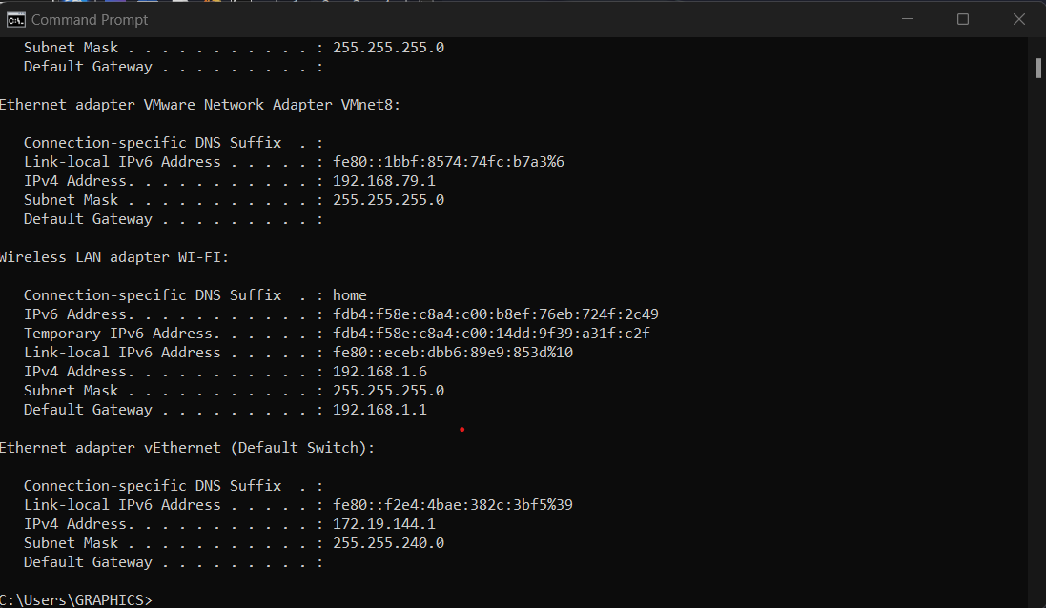
Perform TCP SYN Scan with Nmap in Kali Linux

Slide 8
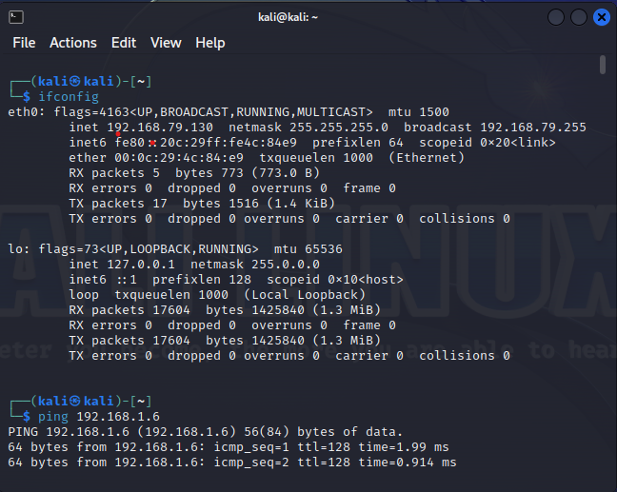
Perform TCP SYN Scan with Nmap in Kali Linux

Slide 9
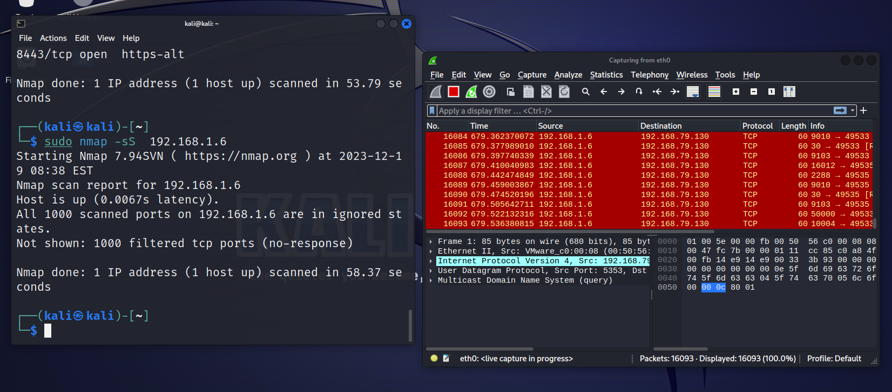
Perform TCP SYN Scan with Nmap in Kali Linux

Slide 10
Perform TCP SYN Scan with Nmap in Kali Linux

Slide 11
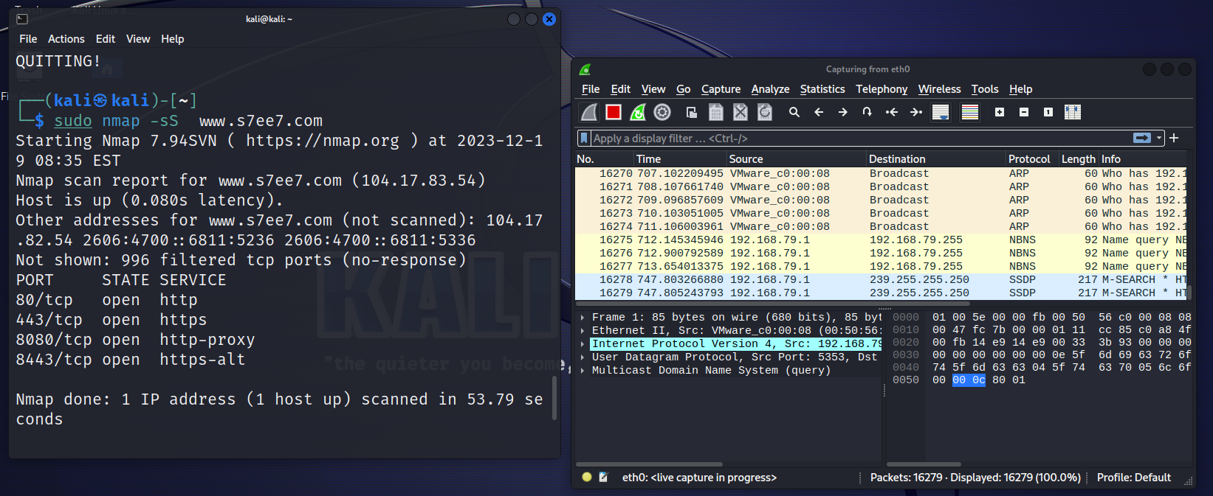
Perform TCP SYN Scan with Nmap in Kali Linux

Slide 12
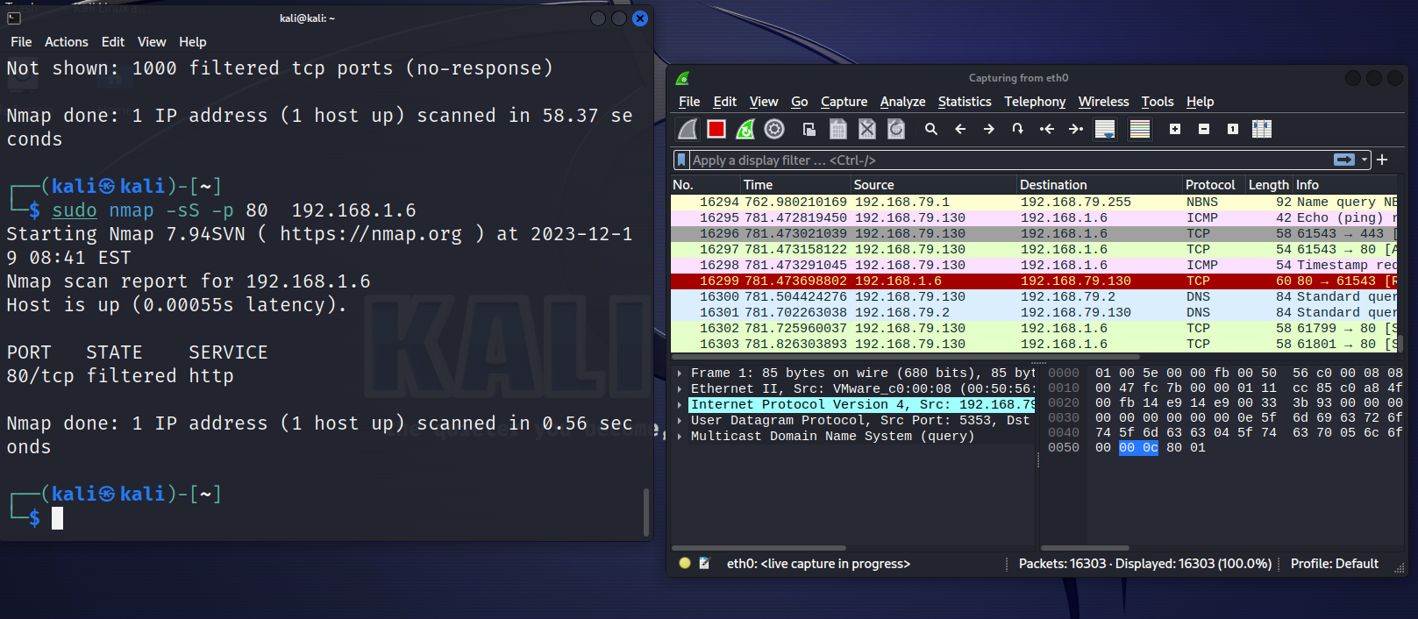
Perform TCP SYN Scan with Nmap in Kali Linux

Slide 13
We select Python script serves as an interactive encryption and decryption tool, allowing users to encrypt and decrypt messages using different ciphers. The supported ciphers include the Caesar Cipher, Playfair Cipher, and Monoalphabetic Cipher. The script leverages the IPython widgets library to create a user-friendly interface.
Cipher encrypt and Decrypt

Slide 14
Functions: caesar_cipher_encrypt(text, shift): This function encrypts the given text using the Caesar Cipher with a specified shift. caesar_cipher_decrypt(text, shift): Decrypts the given text using the Caesar Cipher with a specified shift. prepare_text(text): Cleans the input text by removing non-alphabetic characters and converting it to uppercase. build_monoalphabetic_mapping(key): Constructs a monoalphabetic substitution mapping based on the provided key.
Cipher encrypt and Decrypt

Slide 15
Functions: monoalphabetic_cipher_encrypt(text, key): Encrypts the given text using the Monoalphabetic Cipher with a specified key. monoalphabetic_cipher_decrypt(text, key): Decrypts the given text using the Monoalphabetic Cipher with a specified key. playfair_cipher(plaintext, key, mode): Encrypts or decrypts the given plaintext using the Playfair Cipher with a specified key. encrypt_or_decrypt(button): Event handler for the encryption/decryption button. Determines the selected cipher and performs the action. clear_widgets(): Clears the input and result widgets.
Cipher encrypt and Decrypt

Slide 16
Widgets: plaintext_entry: Text input for the plaintext message. cipher_dropdown: Dropdown for selecting the cipher type (Caesar, Playfair, Monoalphabetic). key_entry: Text input for providing the key for the selected cipher. action_dropdown: Dropdown for selecting the action (Encrypt or Decrypt). encrypt_button: Button for triggering the encryption or decryption process. clear_button: Button for clearing the input and result widgets. result_label: HTML widget for displaying the result of the encryption or decryption operation.
Cipher encrypt and Decrypt

Slide 17
Usage: Enter the plaintext message in the plaintext_entry widget. Select the desired cipher type from the cipher_dropdown widget. Provide the key in the key_entry widget. Select the action (Encrypt or Decrypt) using the action_dropdown widget. Click the Encrypt/Decrypt button to perform the encryption or decryption. The result will be displayed in the result_label widget.
Cipher encrypt and Decrypt

Slide 18
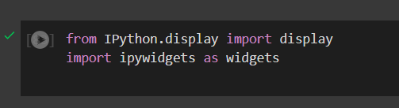
Step 1:

Slide 19
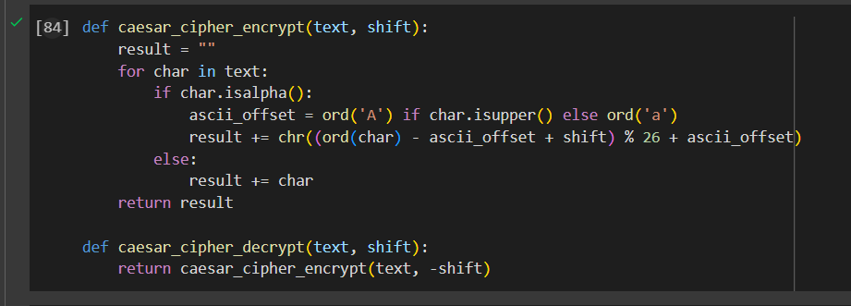
Step 2:

Slide 20
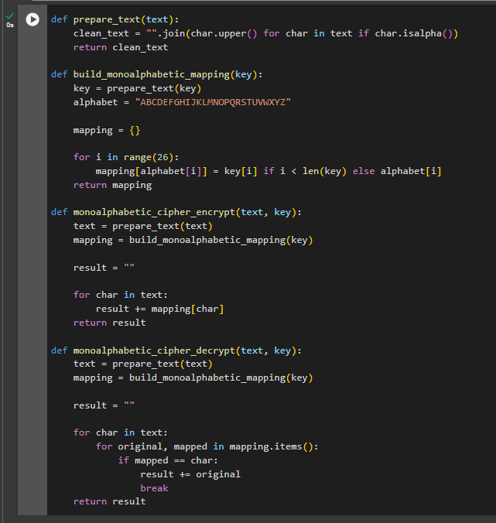
Step 3:

Slide 21
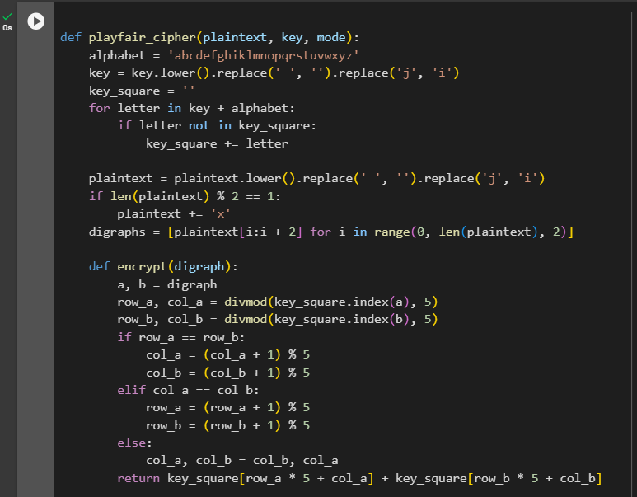
Step 4:

Slide 22
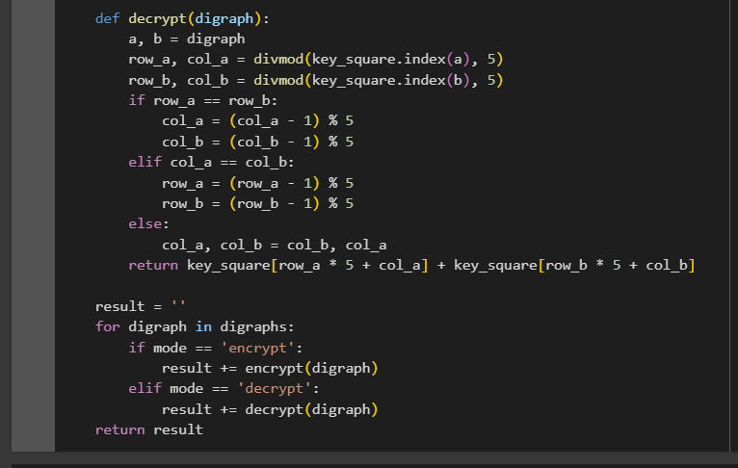
Step 4:

Slide 23
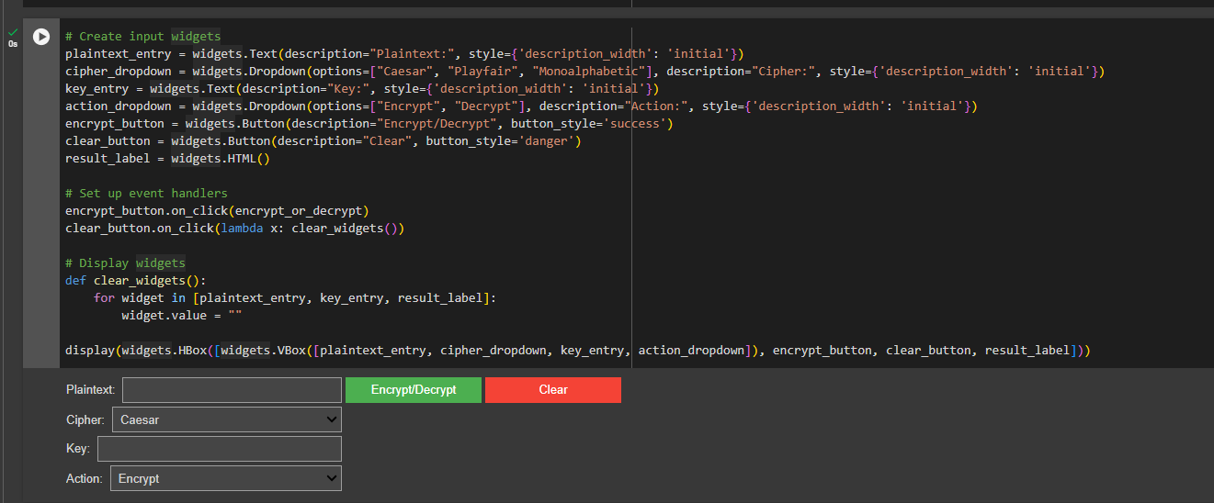
Step 6:

Slide 24
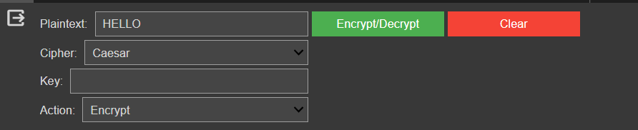
Step 6:

Slide 25
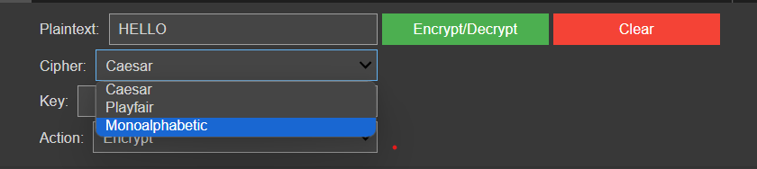
Step 6:

Slide 26
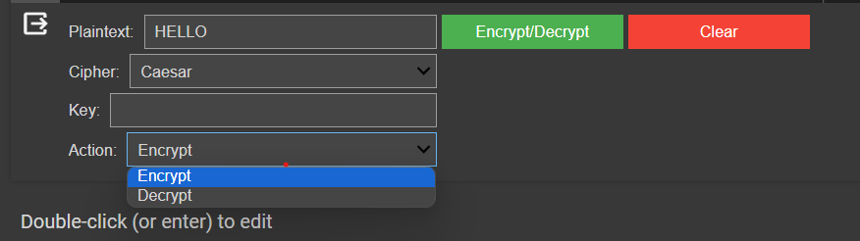
Step 6:

Slide 27
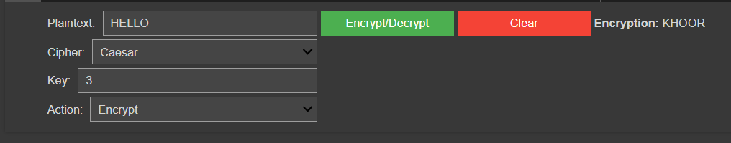
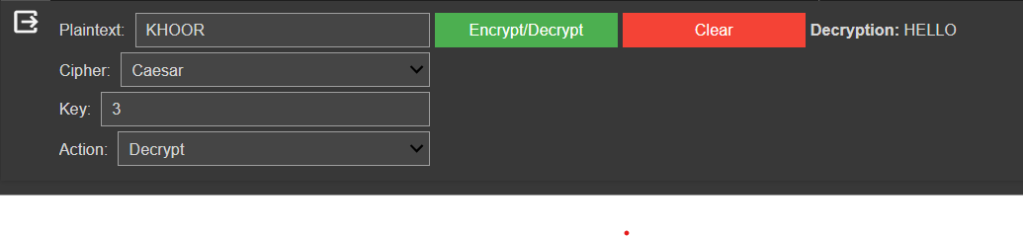
Step 7: Test case

Slide 28
Step 6:
Code link:
https://colab.research.google.com/drive/1jIt73MPqL6B1yg4CLHCNv_26WUG3cMTl#scrollTo=9P4D3U3pv_V9

Slide 29
Thank you

